Slide 1
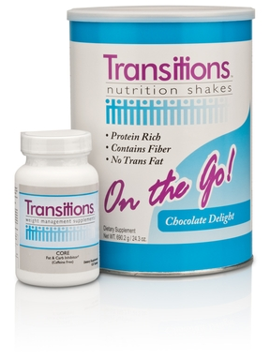
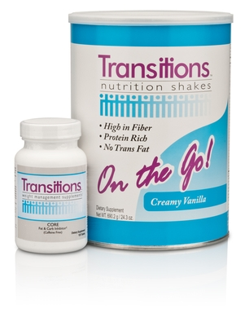
TLS® Quick Start Kit
One TLS® Shake & One TLS® CORE
(Chocolate Delight or Creamy Vanilla Shake)
Code #: 6439C / 6439CNM – Chocolate Delight
Code #: 6439V / 6439VNM – Creamy Vanilla
Distributor Cost: $50.00
Suggested Retail: $69.95
BV: 20
Good Through February 3rd

