Slide 1
Market America’s Strategic Advantage
…in building an UnFranchise® Business

Slide 2
The Strategic Advantage…
is the competitive advantage one business has over its competitive rival entities within a certain industry.

Slide 3
Why Know Your Strategic Advantages
Outperform Your Competitors
Implement a Value-added Strategy
Superior Performance
Keeps you ahead of the curve!

Slide 4
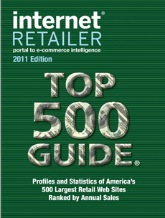
Your Strategic Advantages
A Dynamic Business Model
Product Brokerage
Diversity
Customer Share
Share of Customer
Market-Driven
Ranked #61
Out of hundreds of millions

Slide 5
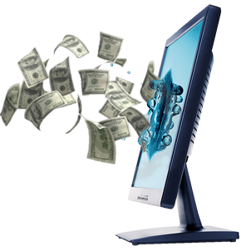
Your Strategic Advantages
Systemization and Structure
Retail System verse A Buying System
Profitability and Stability
Residual Income
A Business that can be Passed On

Slide 6
Your Strategic Advantages
The Management Performance Compensation Plan – “MPCP”
Built on the powers of two
Tracking system designed to accumulate BV and IBV infinitely
Accrual of volume from 365 to 720 days
Optimal Entry-Master UnFranchise® Business
Own Multiple Business Centers

Slide 7
Your Strategic Advantages
The Management Performance Compensation Plan – “MPCP”
100% BV and IBV credit throughout the line of distribution
Weekly Commission Checks
Ability to place Business Volume
Built on paying out the maximum commission
Built on what an Average Person can Realistically and Actually Do

Slide 8
Your Strategic Advantage…
The National Meeting Training Seminar System
(NMTSS)

Slide 9
NMTSS
A cohesive system of meetings, seminars, and events that provide new and established distributors with individual learning opportunities that contribute thorough, standardized and effective training.

Slide 10
NMTSS Components
UBP UnFranchise® Business Presentation
Required Trainings
New Distributor Training – (NDT)
Basic 5 – (B5)
Executive Coordinator Certified Training – (ECCT)
Local Seminars
World Conference
National Convention
Leadership Conference

Slide 11
NMTSS Advantage
Unique and a Privilege
Implemented By Distributors
Leverages Time, Money and Human Resources
Builds Belief
Promotes Duplication
Validates your Business
Provides a Recognition Platform

Slide 12
What Must I Do To Make It Work
Set Calendar Dates
Tickets in Advance
Be in Attendance
Bring Qualified Prospects or New Distributors – (< 6 months)
Become a Component of the System
Build Event to Event

Slide 13
Selling Tickets
We are ticket brokers
Recognize the value – know the content
We are promoters of the next speaker
Must hand over tickets in advance
Must commit to building event to event
Set goals
Be accountable
Set consequences

Slide 14
Your Strategic Advantages
The Management Performance Compensation Plan – “MPCP” Different than MLM’s
Vertical verse Horizontal Distribution
No Levels
No Breakaways
Accrual of volume from 365 to 720 days
Own Multiple Business Centers
A plan built on helping other people to succeed

Slide 15
Your Strategic Advantages
Optimal Business Platform
Your webportal is your store front – “Shop.com/dennisfranks”
High tech – high touch…”Shop Consultant”
Social shopping and Viral Marketing tools to make it happen!
MA Marketing Strategy – “The Octopus Philosophy”

Slide 16
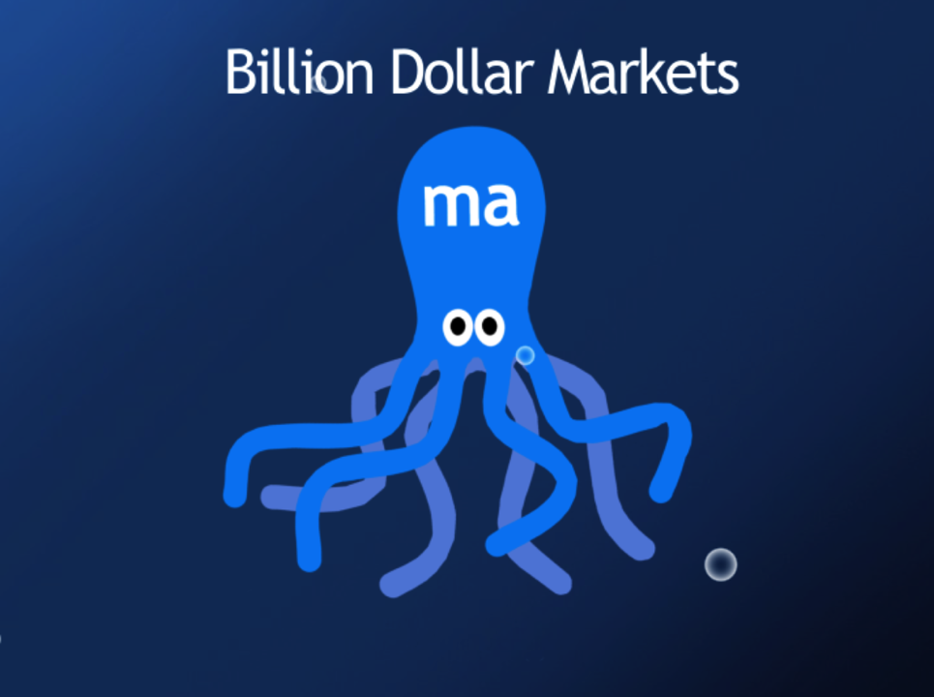

Slide 17
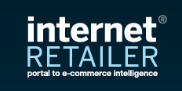
Your Strategic Advantages
Shop.com Acquisition
Technology
URL “Shop.com”
Human Resources
Customers
Acquisition in News
Coverage in over 300 media outlets

Slide 18
Your Strategic Advantages
Multiple Marketing Engines
Internet Sales
Home Shopping Sales
Catalog Sales
Direct Sales
Network Marketing Sales
Franchise Sales

Slide 19
®
ma
Components That Drive Your Success
Product Brokerage
Training & Support
Internet Marketing Support
& Social Media
Social Shopping & One-to-One Marketing
Our systems, tools and technologies support your efforts to generate an ongoing income.
Notes:
19

Slide 20
Market America’s Strategic Advantage
…in building an UnFranchise® Business

