Slide 1
marketamerica
®
‘My List’ Functionality
Notes:
1

Slide 2
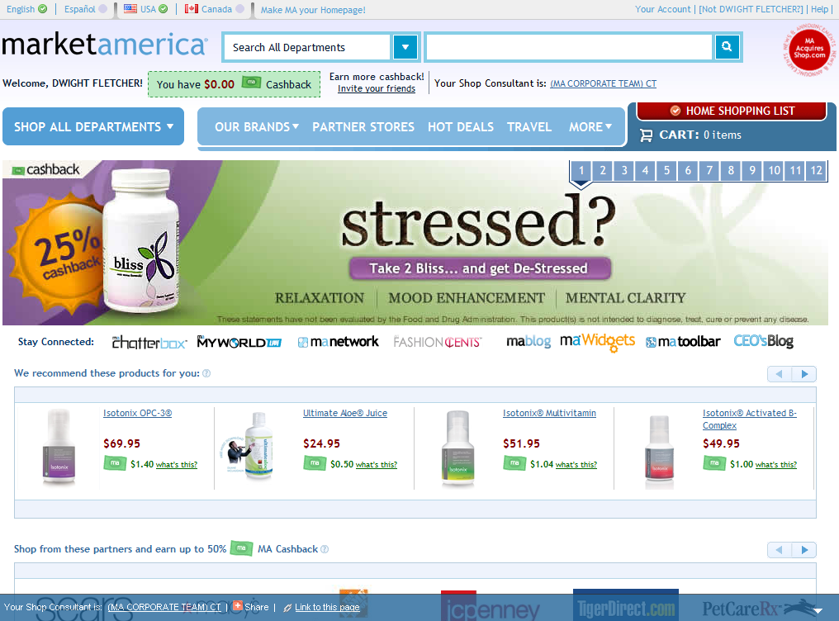
Preferred Customer
Click ‘HOME SHOPPING LIST’ on the right
Notes:
2
2
2

Slide 3
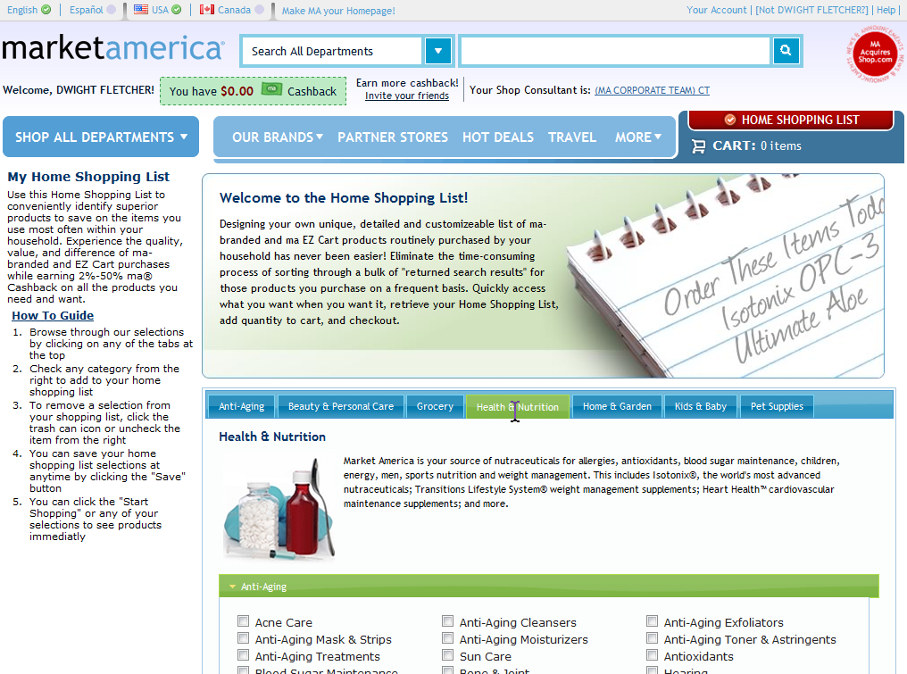
Preferred Customer
Select categories in which you already shop
Notes:
3
3
3

Slide 4
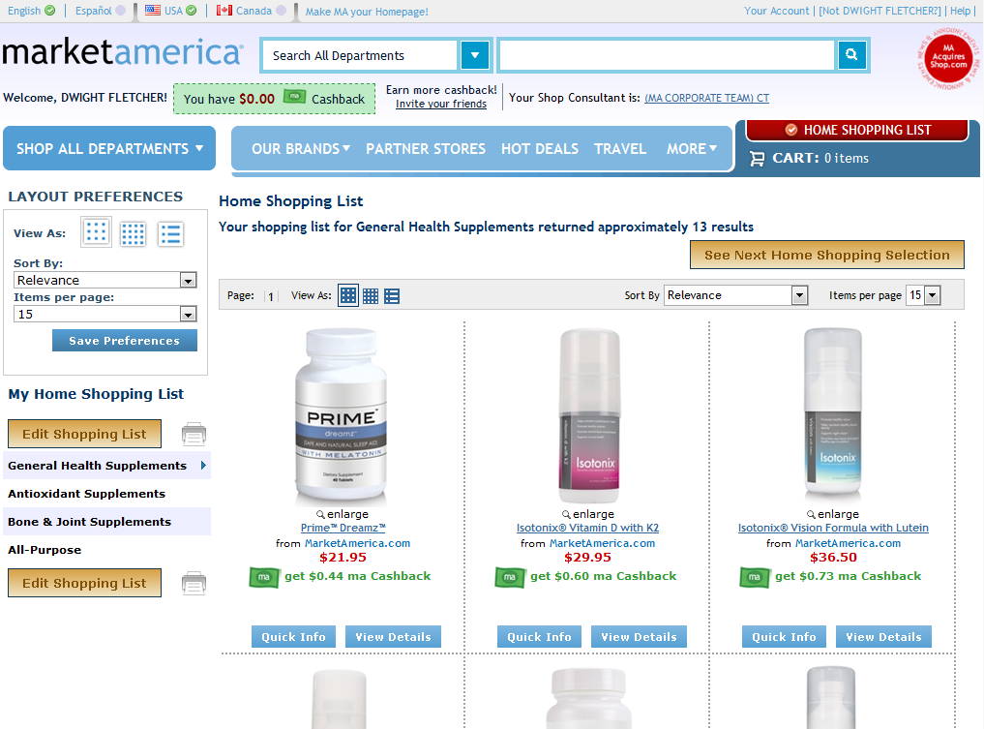
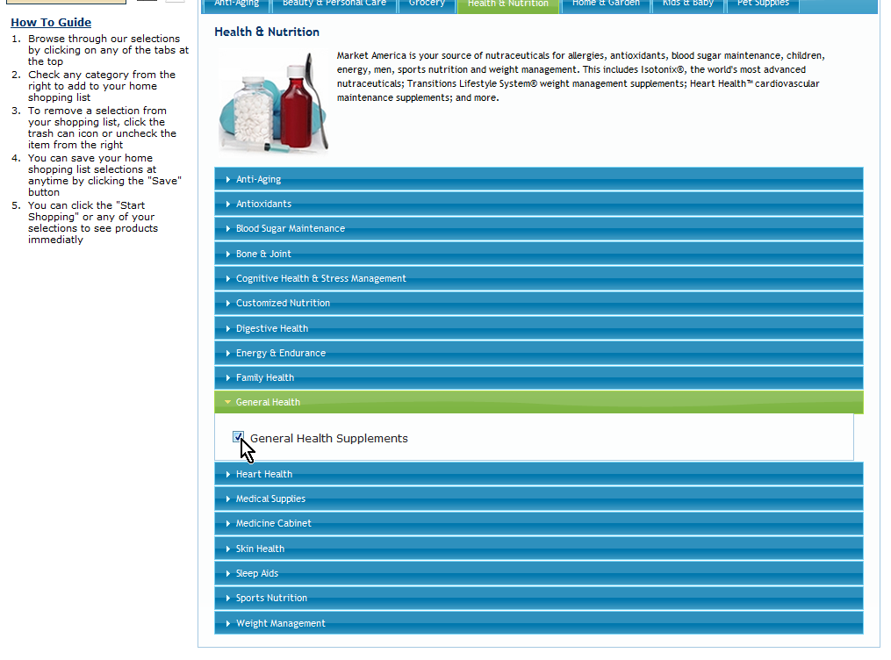
Preferred Customer
Select items you already buy
Notes:
4
4
4

Slide 5
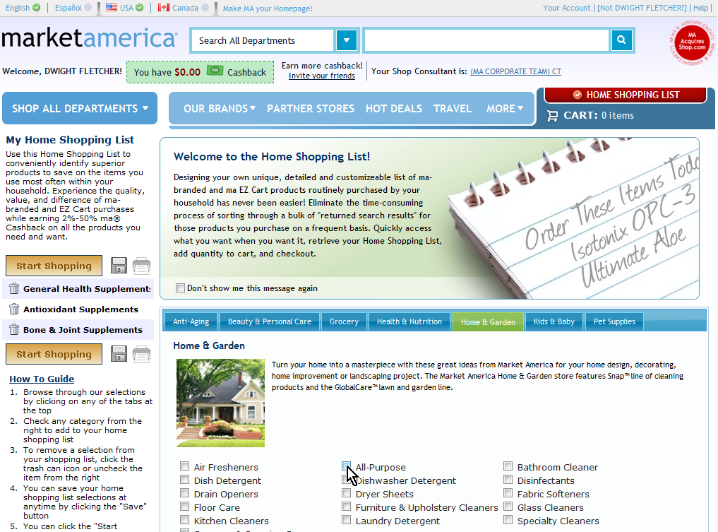
Preferred Customer
Select ‘Start Shopping’ when you are ready
Notes:
5
5
5

Slide 6
Preferred Customer
‘Quick Info’ brings up details about the product
Notes:
6
6
6

Slide 7
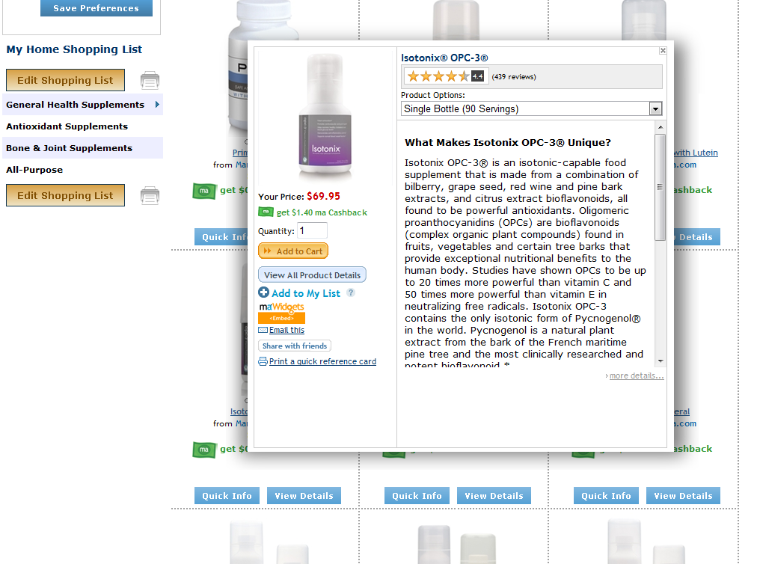
Preferred Customer
‘Add to My List’ to make future shopping easy
Notes:
7
7
7

Slide 8
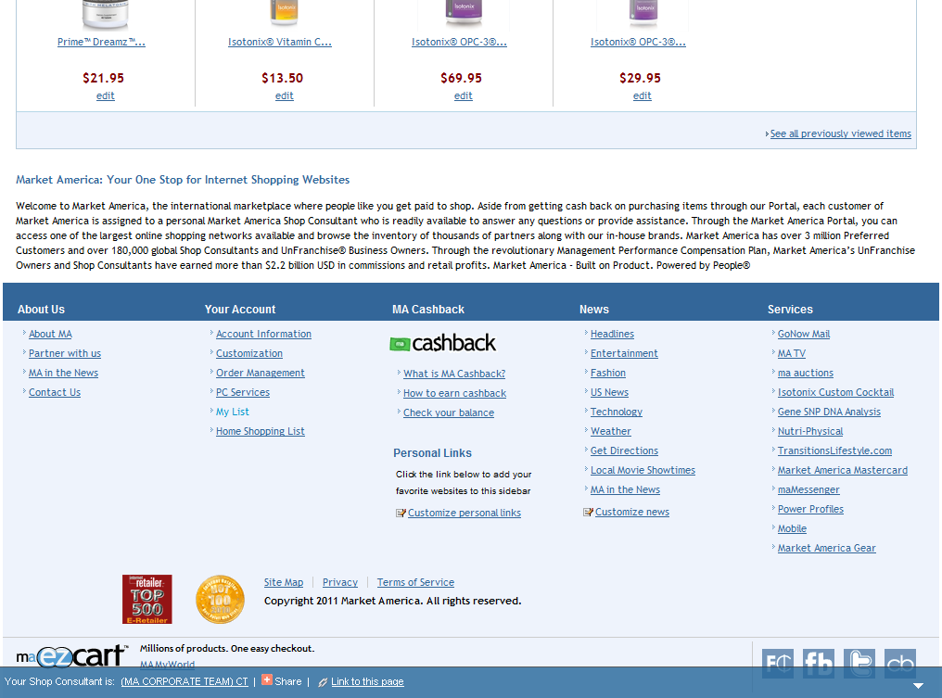
Preferred Customer
Access ‘My List’ at the bottom of any page
Notes:
8
8
8

Slide 9
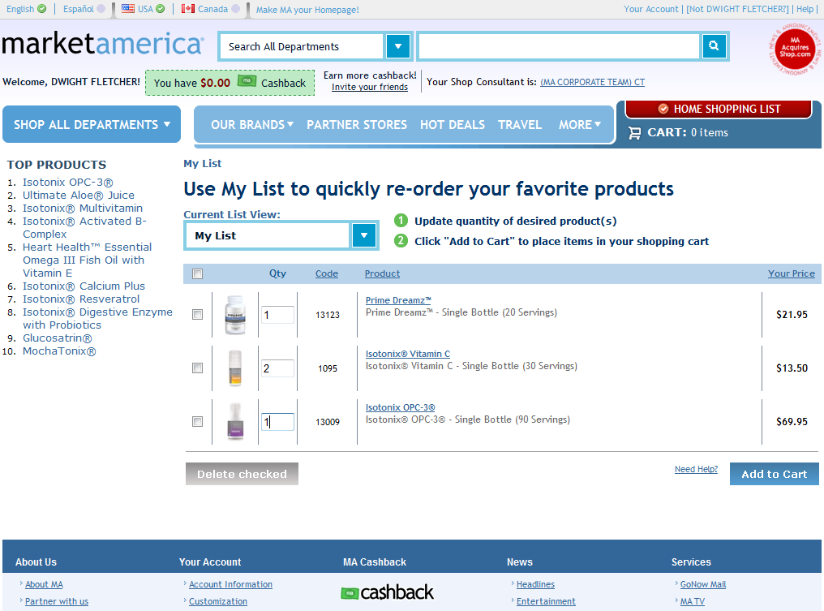
Preferred Customer
Select quantities and ‘Add to Cart’
Notes:
9
9
9

Slide 10
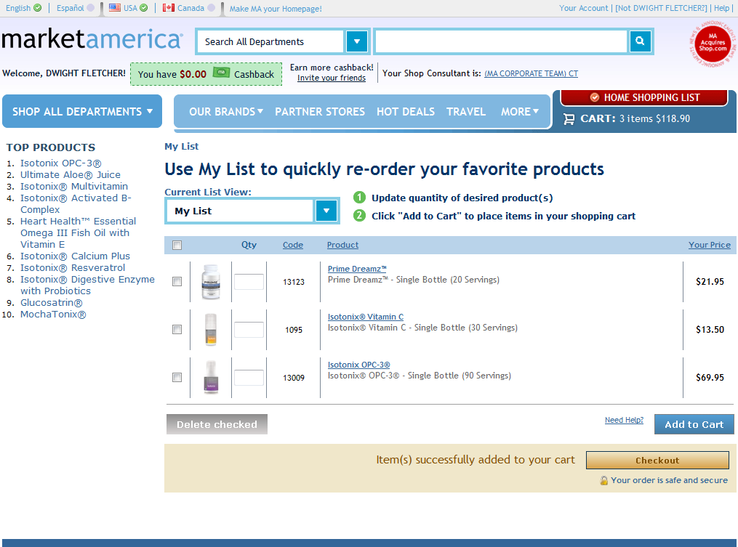
Preferred Customer
Click ‘Checkout’
Notes:
10
10
10

Slide 11
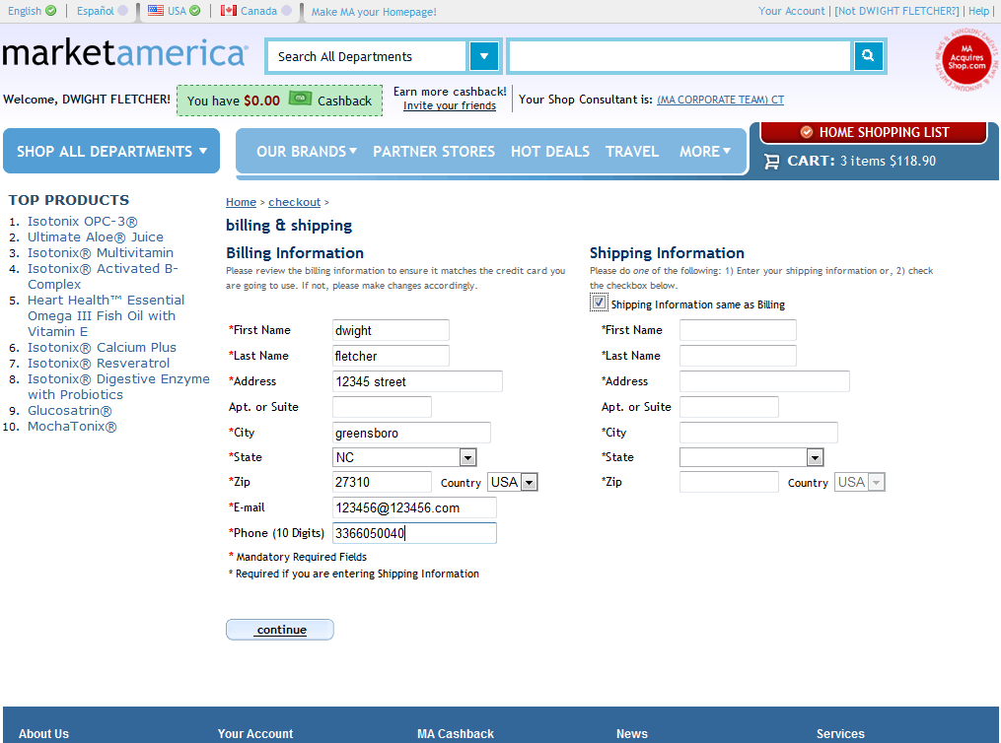
Preferred Customer
Complete the checkout process
Notes:
11
11
11

Slide 12
Notes:
12
12
12

Slide 13
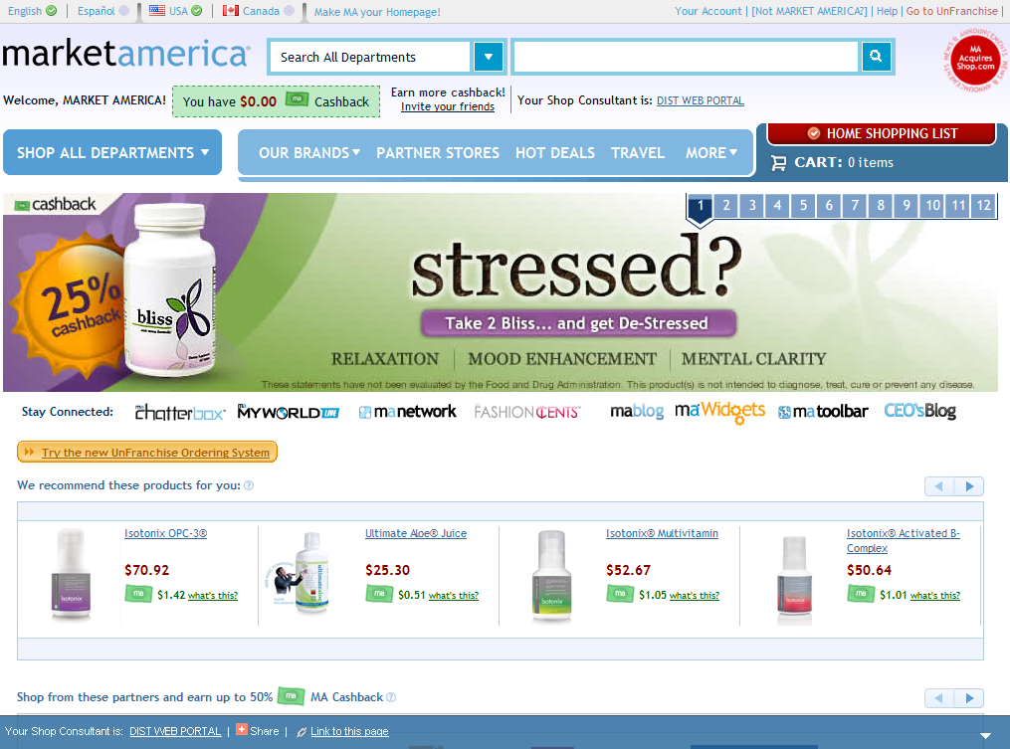
Distributor
Logged in as a PPC, select ‘New UnFranchise Ordering’
Notes:
13
13
13

Slide 14
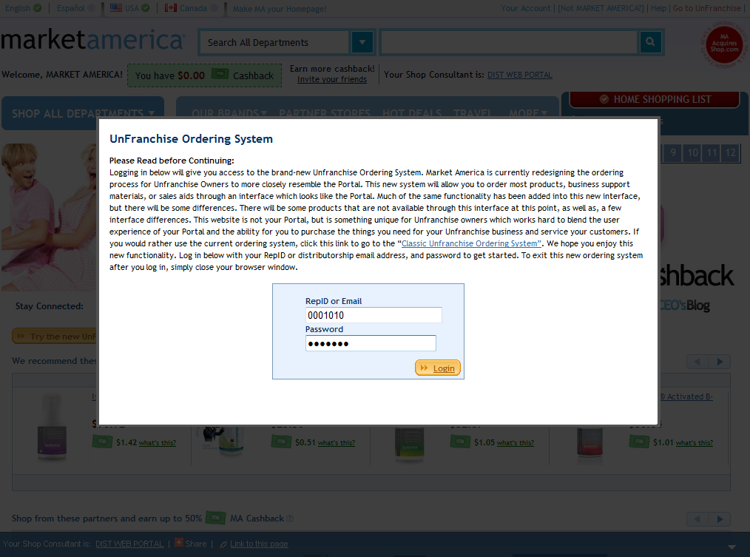
Distributor
Log in with Rep ID and Password
Notes:
14
14
14

Slide 15
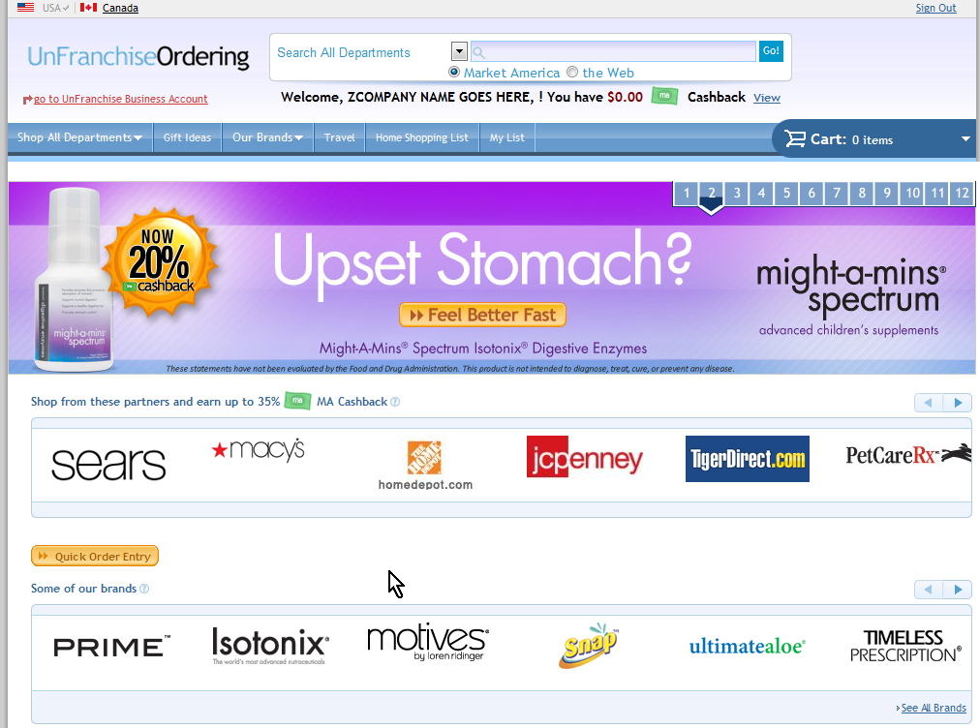
Distributor
Click ‘Home Shopping List’
Notes:
15
15
15

Slide 16
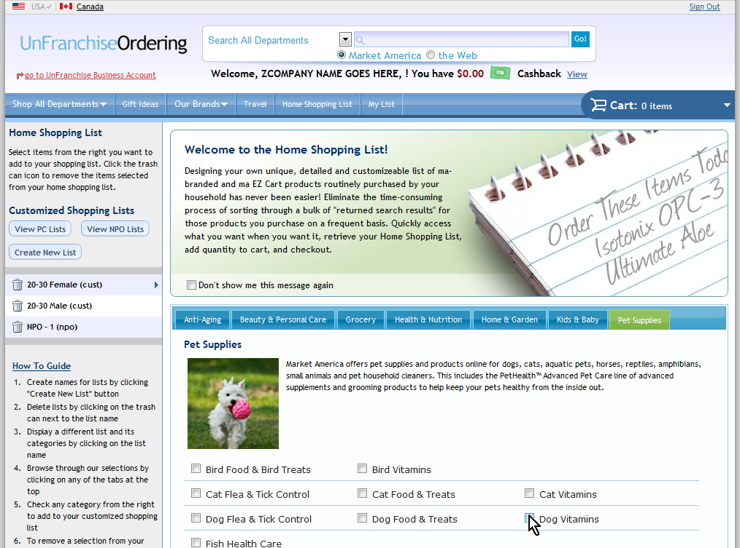
Distributor
Select categories in which you already shop
Notes:
16
16
16

Slide 17
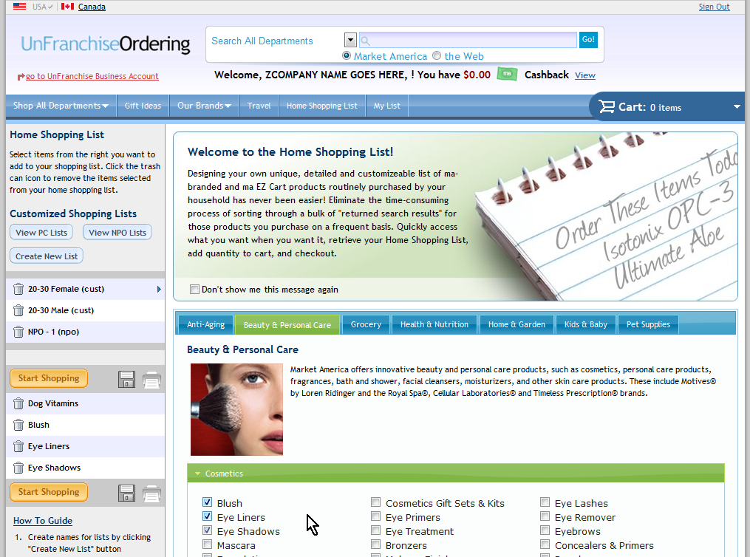
Distributor
Click ‘Start Shopping’
Notes:
17
17
17

Slide 18
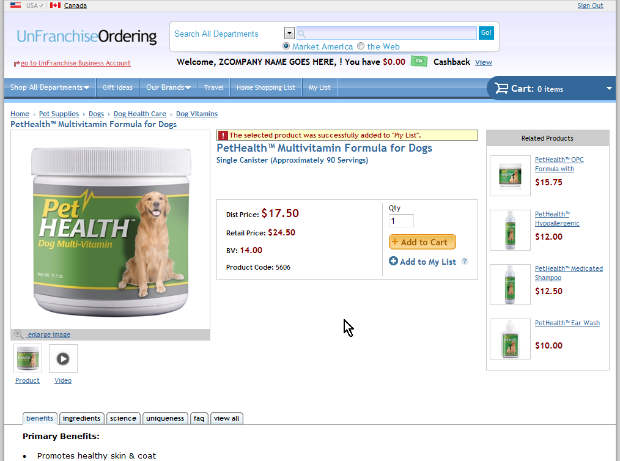
Distributor
After selecting ‘Add to My List’ you get confirmation
Notes:
18
18
18

Slide 19
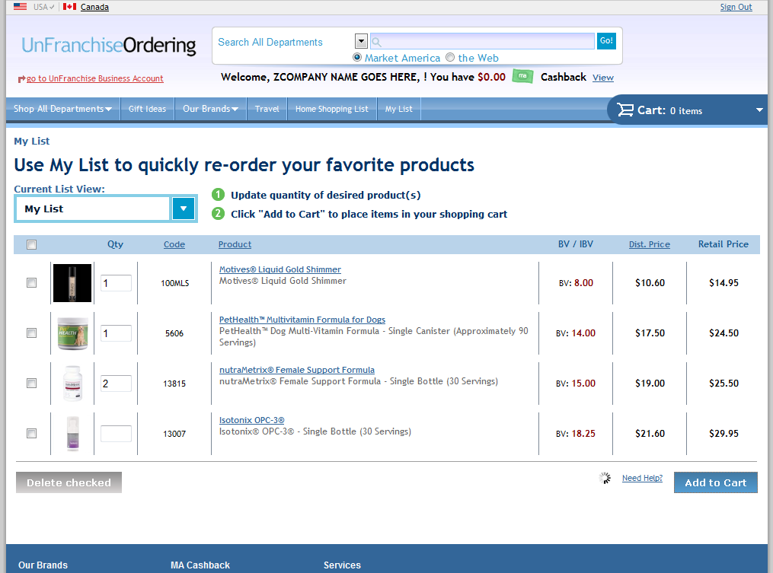
Distributor
My List makes it easy to select quantities of frequently ordered products quickly
Notes:
19
19
19

Slide 20
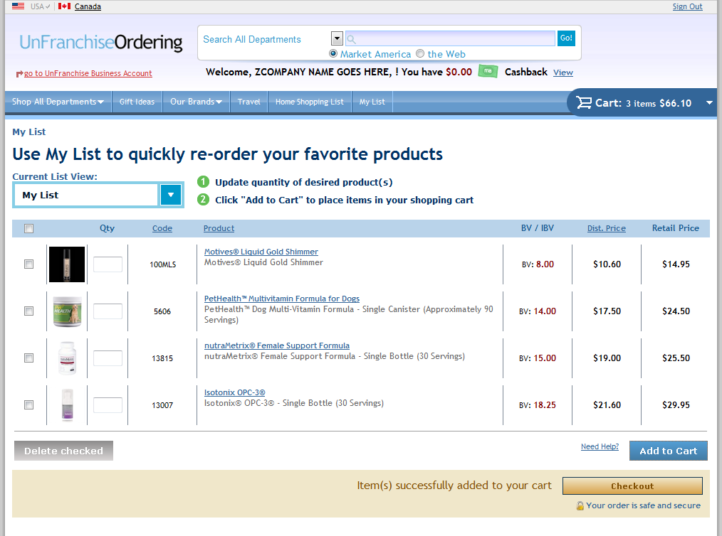
Distributor
Continue to checkout
Notes:
20
20
20

Slide 21
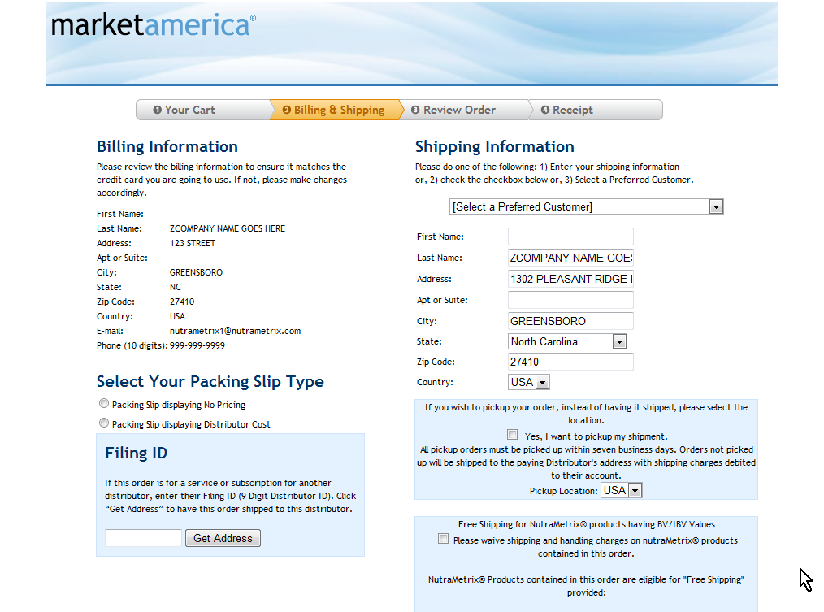
Distributor
Complete the checkout process
Notes:
21
21
21

