Slide 1
LEADERSHIP
and The Role of “Time Management”

Slide 2
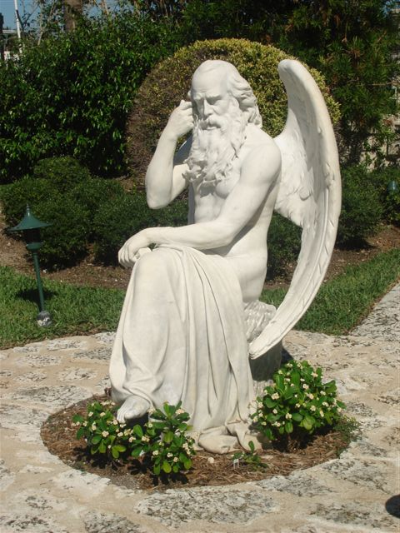
TIME IS THE
GREAT EQUALIZER
We all have it.
We can’t stop it.
What are you going to do with it?

Slide 3
Time management is…
the act or process of exercising the conscious control over the amount of time spent on specific activities especially to increase…

Slide 4
Production and Efficiency of…
Residual Income
Building your List
Facebook Time – (identifying possibilities)
Number of Approaches
Number of Appointments Booked
Number of Plans Shown
Retailing
Recruiting

Slide 5
Production and Efficiency of…
Selling Tickets
Internet Marketing
Follow Up
Referrals
Cashback
Whatever…

Slide 6
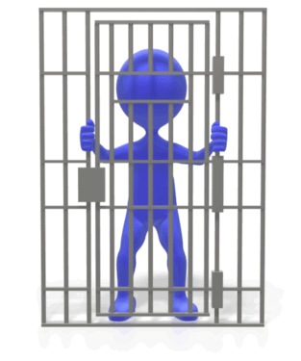
BREAKOUT!!!

Slide 7
That is; Whatever is most important to you!
Time Management
in the
“Right Perspective”

Slide 8
You focus on the “MAIN THING”… and measure the traction.
How do we get more VALUE out of time?

Slide 9
The “Think through”
You have your goal. We equate it to a financial number, then pin level. To reach it, we set a plan of action, (make it real) and we work the plan. Keys - focus and execution (The Main Thing)
Once we reach it, we need to maintain it. “Consistent Income”, the true residual income. What does that take? To build Directors in each of your organizations supported by other Directors!
(The Main Thing)

Slide 10
Your Focus Must Adjust
Same drills as before with an adjusted focus to the organizational leaders. Like, building depth in the common leg for speed. You are building security through more distributors earning meaningful income.

Slide 11
There is always a “Method to our Madness”

Slide 12
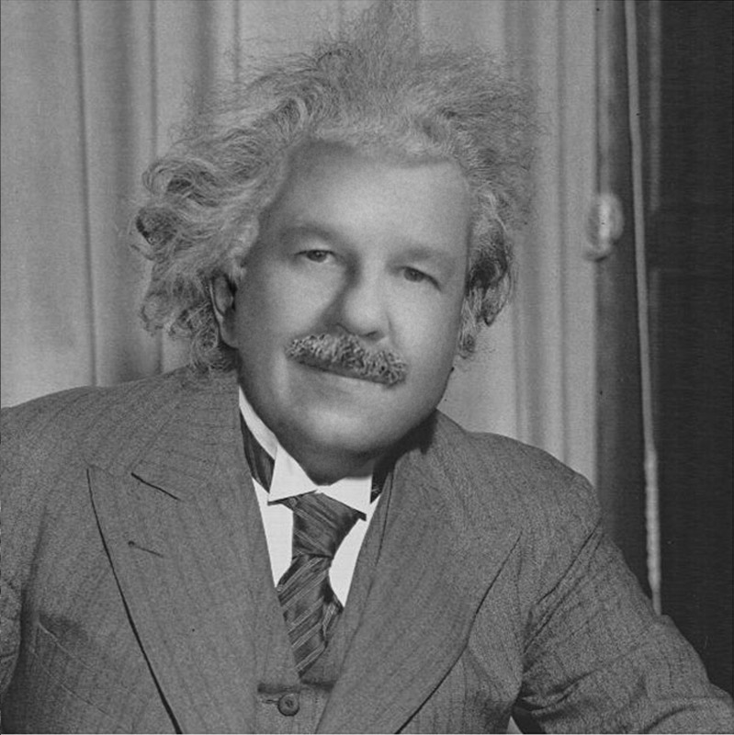
There is always a “Method to our Madness”
BV + IBV = $ (Residual)

Slide 13
Things to take into consideration in managing your time…
Family, Work, Religion
How much time has been allotted for your UnFranchise® Business?
What is the goal of your UnFranchise® Business?
What is the timeline set to meet your goal?
What do you rate your current skill level?
Sets your training schedule, always a minimum of events

Slide 14
Things to take into consideration in managing your time…
5. What do you rate your current discipline level? Why?
What do your rate your current duplication level? Why?
Are you willing to make some changes to accomplish what you want?

Slide 15
the “must dos” of our business?
What are…
Sell Product
Sell the Business
Sell Education
Sell the Webportal (your location of business, your “Store Front”

Slide 16
The “WHY” of SHOP.COM
Notes:
As we continue our transition over from MarketAmerica.com as the primary shopping site to SHOP.COM, I began to look at how we can transition our customers to becoming loyal SHOP.COM customers.

Slide 17
To revolutionize the way people shop for products and services online.
WHAT
HOW
WHY
Notes:
In any organization, there are three levels of awareness, What, How and Why. More specifically in this case thinking of people we want to shop at our site: What do we do? How do we do it? And Why is what we do important to you?
The WHAT is effectively put in our mission statement – To revolutionize the way people shop for products and services online. But is the WHAT enough to change where you shop? Most likely no.

Slide 18
Price Alerts
WHAT
Technology & Merchandising
Buying Guides
HOW
Cashback
Hot Deals
WHY
Invite Friends
Trend Shops
Shop Consultants
Home Shopping List
2000+ Stores
OneCart
Notes:
The HOW get a bit more complex as SHOP.COM has so much to offer. Some of the most visual are listed here, but we could go on and on. Still, is the HOW enough to get a customer to change their shopping habits? …..Maybe….

Slide 19
Control
Community
WHAT
HOW
WHY
Cash
Convenience
Comparison
Notes:
The WHY is where people make their decisions. Like with buying a diamond where you need to know the 4 C’s – I’ve put together the 5 C’s of WHY SHOP.COM.
Control – You, the shopper, control the entire shopping experience.
Convenience – shop when you want, from anywhere, at thousands of stores in one location. Products shipped directly to your door, freeing up your time for other, more important tasks.
Community – invite your friends, share your trends.
Comparison – seeing prices from multiple stores on one site gives you confidence that you got the best deal… no more buyer’s remorse.
Cash – all the above plus getting cash back on your purchases (and referral purchases).

Slide 20
Try SHOP.COM?
Great website…
WHAT
HOW
Features & Benefits
Compare at 100’s of stores
WHY
Want to shop?
Find it cheaper?
Notes:
It’s generally ineffective to sell anything from the outside in… “We have this great web site, it has all these features, don’t you want to shop there?
Instead, you start from the inside out… Hate finding something cheaper down the street just after you bought it? My web site will let you compare prices at hundreds of stores at the same time and get the best deal anywhere. Want to try SHOP.COM?

Slide 21
The “WHY” of SHOP.COM
Notes:
As we continue our transition over from MarketAmerica.com as the primary shopping site to SHOP.COM, I began to look at how we can transition our customers to becoming loyal SHOP.COM customers.

Slide 22
It is simple but so much more…
You must be aware and use the right arrows in your quiver that determines your success!

Slide 23
Sell Products; Sell Your Portal
What products; what portal - (your storefront)
Knowledge of those products…
Personal Experience
Benefits
Features
Knowledge of your webportal
Personal Experience (Make it your Homepage)
Benefits
Features

Slide 24
Internet Marketing Tools Available
Webportal
Share With Friends
Email A Friend
Videos
Online Shopping Parties
maTV
Customer Reviews
ma Network
Shop Box
PRM
E-flyers
Social Networking
Invite Friends Tool
Alerts

Slide 25
Traditional Tools
Trade Shows
Product Previews
Product Sampling
Testimonials
Downloads
Brochures
Catalogs
Direct Mail

Slide 26
NMTSS
University Major Overviews – (UMOs)
Product Trainings (TLS Day 1, Motives Day 1)
Product Symposium
Certification Trainings

Slide 27
SELLING THE BUSINESS
What is the business?
Your answer to “what is it”
What do you do
Two-minute commercial
How do you earn income? (know the MPCP)
Your answer to “what is residual income”
What is leverage
Importance of duplication
Are you speaking the right language

Slide 28
SELLING THE BUSINESS
Having a list, making an approach, booking appointments – (call workshops)
Showing The Plan, Booking a Follow up to Showing The Plan and selling a ticket

Slide 29
Internet Tools Available Viral Marketing Tools
maTV
The Power Profiles
The UBP
The Plan
Webportal
PowerLine Magazine
UnFranchise Management Tool – (UFMS)
PRM
About MA
Downloads

Slide 30
Traditional Tools
Audios – (MP3 Player)
Flip Chart
UBP DVD
Getting Started Guide
Annual Report
Magazines and Articles
Ma University / Product and service diversity to drive the pay plan
Three-way Calls

Slide 31
NMTSS
UBPs
Basic 5
Local Seminars
University Major Overviews
Special Business Building Seminars

Slide 32
Selling Tickets
Know the NMTSS Schedule
Understands the value of each NMTSS event.
Buy tickets in advance. (can’t sell a ticket you don’t have)
Become a Promoter - (know your speaker background)
Selling the value by knowing the pain of your prospect – (the why)
Know how the ticket leverages time

Slide 33
Know When To Sell A Ticket
When reviewing the Getting Started Guide
At sign up – leverage the Fast Start Entry Kit and their “why”
At lunch at an event
At the UBP
At the HBP
When setting their schedule

Slide 34
After The Ticket Is Sold
Congratulate the Prospect for doing the right thing
Reinforce that buying the ticket is an essential stepping stone to success
Review how to liquidate the cost of buying a ticket
Offer a plan
Discuss how tickets and attendance at events is the best measurement to becoming a success and their business growth

Slide 35
The most important word that associates to “Time Management” is…
“SCHEDULE”
A plan for performing work or achieving objectives. Specify the priority and allotted time for each task.

Slide 36
Schedule Components
Create a general schedule for the year
Create a secondary schedule for the quarter – (three-month increments)
Create a primary schedule
Monthly
Weekly

Slide 37
The General Calendar (The Year Ahead)
Family Dates – (birthdays, anniversaries, graduations, vacations)
Work Obligations
Religious Obligations
MA Major Events – (World Conference, International Convention, Regional Conventions, Special Business Building Seminars, Product Symposium)

Slide 38
The Quarterly Calendar
Local Seminars – (Charlotte NMTSS)
UBPs – (UnFranchise Business Plans – Kernersville, North Carolina)
University Major Overviews
Product Trainings
Core Working Hours – (these are the (2) three-hour blocks necessary to build the business, ABC Pattern, HBP, UBP, Product Previews, Online Shopping Parties, Showing the Plan; 2 on 1s)

Slide 39
The Monthly Calendar
Selected Work Schedule – (4 – 9 hours weekly)
Initiating Names of Scheduled Appointments
The Weekly Calendar
Inserting the details
Initiating the follow-up details

Slide 40
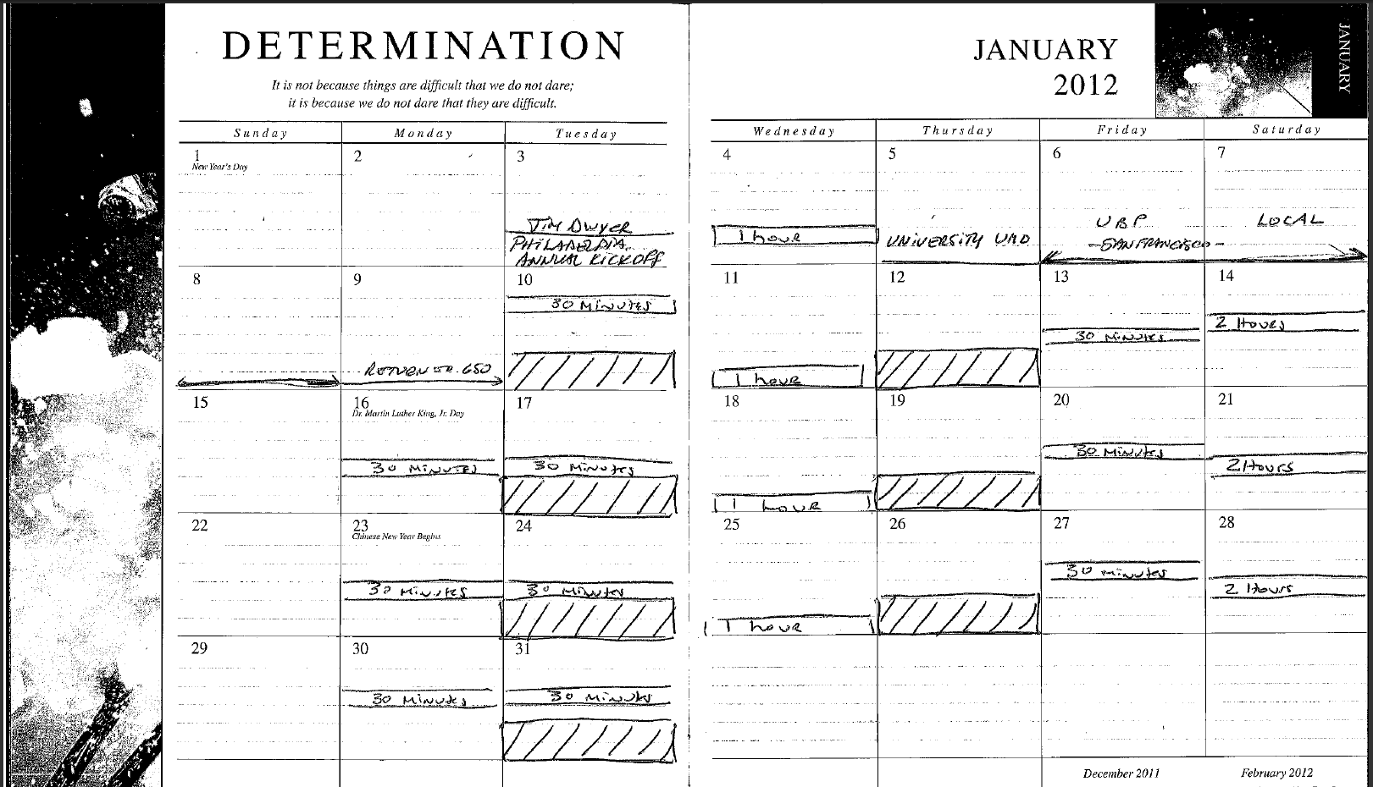

Slide 41
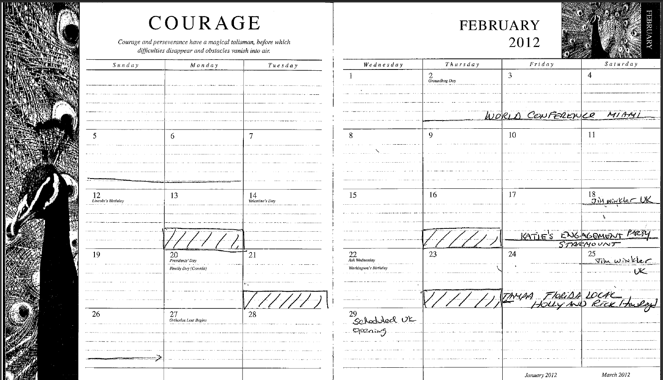

Slide 42
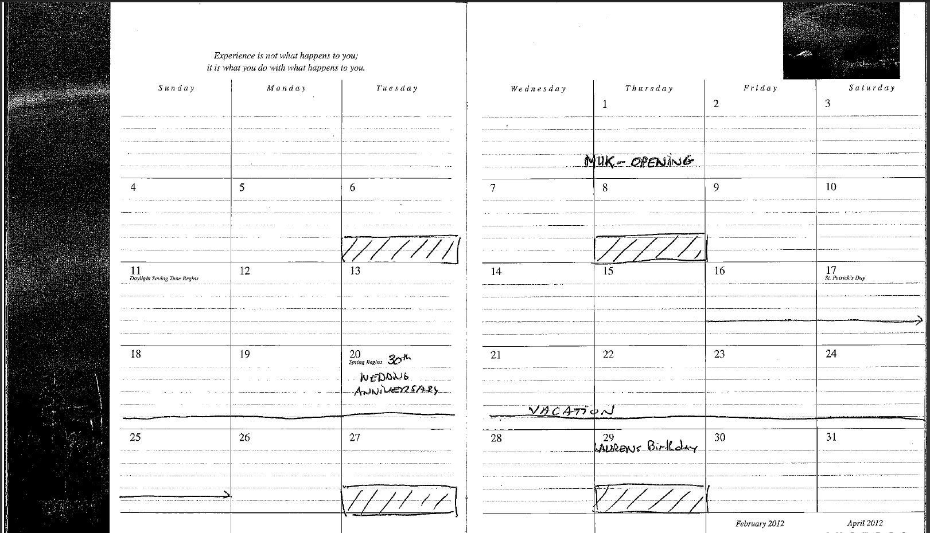
EXPERIENCE
MARCH
2012

Slide 43
Measure / Monitor Your Output Quarterly – (Use The PRM)
Number of Appointments Booked
Number of Appointments Completed
List the Outcomes of the Appointments
Track the follow-up appointments booked – (post the details)
What was the final outcome…
New Customers
New Distributors
Back in the Jar

Slide 44
Make The Necessary Adjustments
Review with Senior Business Partner or Mentor
Discuss the good and areas for improvement
Determine the necessary course of action – (could be a special training to attend or setting 2 on 1s, to bring your mentor into the equation)
Reset your plan of action
Focus and execute

Slide 45
Leadership and The Role of Time Management
Providing the solution through a logical course of action to improve can make the difference between success and failure.

Slide 46
LEADERSHIP
and The Role of “Time Management”

